Slide 1
EdgeGallery MECM

Slide 2
Agenda
ETSI MECM Revisit
MECM Component Design & Architecture
APM
Inventory
APPO
APPLCM with Plugins
AppRule Manager
MECM Deployment
Important Model
MECM Flows
Application Deployment.
DNS & Traffic Rule Configuration
Edge Statistics Collection (Edge Monitoring)
Other Features
Autonomous Edges
VM based Application Support
Service Comb for Platform component service governance
MEPM-FE

Slide 3
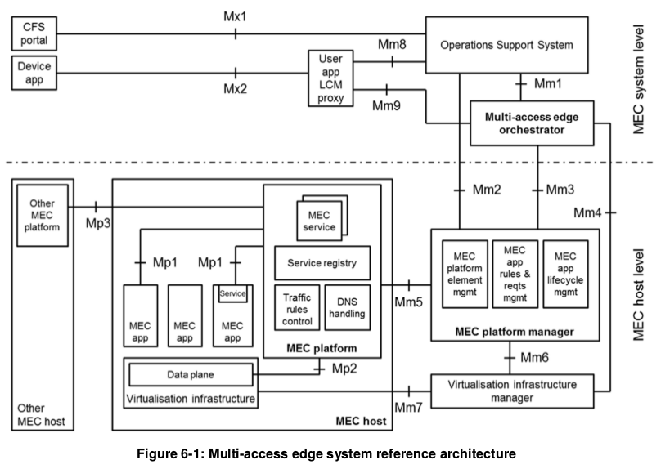
OSS
MEC Orchestrator
Maintenance view: Deployed host, available resources/services and topology
App package management, App repository
Host selection for app deployment
Initiate App instantiation or instance termination
App location migration
receives requests via the CFS portal and from device applications for instantiation or termination of applications
Granted requests are forwarded to the multi-access edge orchestrator for further processing.
receives requests from device applications for relocating applications between external clouds and the MEC system.
MEC Platform Manager
App instance lifecycle management, including status report to the MEO
MEP NE management, including NE and service deployment
Flow and DNS rule management, including rule setting receipe and distribution to each MEP
Virtual resource status, fault report and performance statistics collection for each MEC host
User APP LCM Proxy
allows device applications to request on-boarding, instantiation, termination of user applications
relocation of user applications in and out of the MEC system.
Informs the device applications about the state of the user applications.
Authorizes requests from device applications in the device and interacts with the OSS and the multi-access edge orchestrator for further processing of these requests.
MEC Platform
Provides services governance for apps(Release,discovery, subscription and consumption)
Receives flow rule settings and sends them to the data plane
Receive DNS policies and uses them in DNS services (service/proxy)
Monitors app integration and O&M status
Offer basic app services, including API GW capability exposure.
VIM
Allocating, managing and releasing virtualized resources
preparing the virtualization infrastructure to run a software image.
collecting and reporting performance and fault information about the virtualized resources;
when supported, performing application relocation.
Data Plane
MEC App
Provides Intermediate UPF
App flow scheduling and load balancing
Traffic redirection
Runs on containers/VM of MEC hosts
Interworks with the MEPM via Mp1 interface for lifecycle, flow rule management and service governance
Provides services for other APPs
Access MEC services

Slide 4
ETSI MEC API summary
Mm4 Reference Point
manage virtualized resources of the MEC host, including keeping track of available resource capacity
manage application images.
Mm1 Reference Point
App Package mgmt
On boarding
Search, delete, enable, disable
App Life cycle mgmt
App Instantiation
Termination
Status change
Mm5 Reference Point
Perform platform configuration
Configuration of the application rules and requirements
Performs application lifecycle support procedures
Mm2 Reference Point
Mm6 Reference Point
Mgmt data model definition
Data model, data retrieval from MEPM
Data model change notice to the OSS
Traffic distribution rule addition, activation or deactivation
DNS rule addition, activation, or deactivation
Fault management.
Manage virtualized resource to realize the application lifecycle management.
Mm7 Reference Point
Manage the virtualization infrastructure inside MEC host.
Mm3 Reference Point
App Package mgmt
App package data requesting
App package change notice
App pkg on-boarding notice
App pkg retrieval
App Life cycle mgmt (MEO->MEPM)
App instantiation and termination
App instance status change
Status request
(MEO->MEPM)
App lifecycle change notice
There are three groups of reference points defined between the system entities:
• reference points regarding the MEC platform functionality (Mp);
• management reference points (Mm); and
• reference points connecting to external entities (Mx).
Mm8 Reference Point
Handle device applications requests for running applications in the MEC system.
ETSI Standard Available
VIM Specific API
Mm9 Reference Point
Manage MEC applications requested by device application.
ETSI Standard Not Available
Out of Scope/
Future Study

Slide 5
MECM Component Design & Architecture

Slide 6
Design Considerations/ Requirement
Lower Footprint & network bandwidth availability on Edge (Resource constrained environment with limited bandwidth connectivity)
Use Language like GOLANG
Use Protocol like GRPC
Unstable connection between center & edge
Autonomous Edges with Synchronization to Center when needed.
Portal dedicated for Edge
Ease of supporting new Infrastructures
Plugin based architecture for Plug & Play of Infra’s.
MECM to be agnostic of Infrastructure
Runtime onboarding of Edges (support to add new edges in runtime)
Runtime Edge Registration and support
Support for Flexible Deployments (1 MEPM - 1 Edge, 1 MEPM - Multi Edge, AIO, MUNO etc.)
Loosely coupled (modular/Microservice based) architecture with Edge & MEPM registration mechanism.
Start with minimal requirement and support for Easy extensibility (addition of Placement, closed loop etc.)
Loosely coupled (modular/Microservice based) architecture
Security
HTTPS, Other security considerations
HQ Requirement: Don’t use kubernetes as a basis for MECM

Slide 7
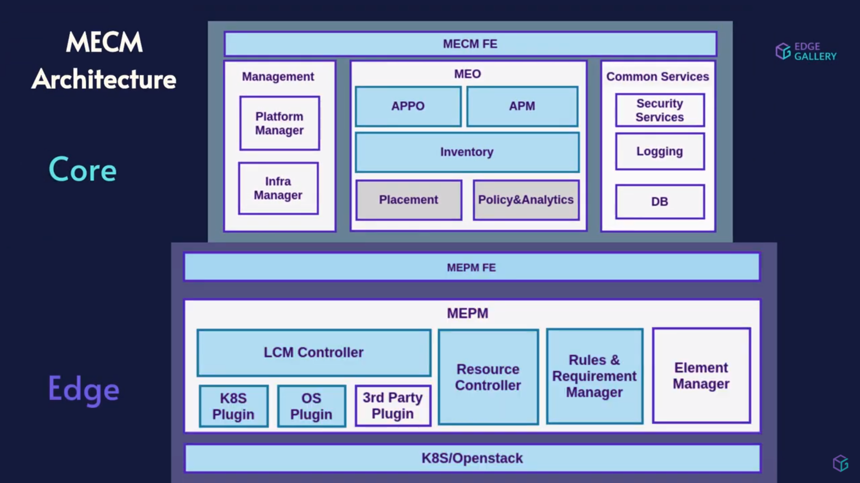
MECM Architecture
Application Package Manager: Application Package Manager(APM) enables edgegallery to distribute/on-board applications packages to edge repositories by downloading application packages from appstore.
Application Orchestrator: Application Orchestrator(APPO) is mainly responsible for MEC application orchestration by requesting for life cycle management of MEC application on the edge host by executing specified workflow while maintaining the life cycle state. Orchestration workflows are modeled using Camunda modeler tool and workflows are executed by camunda engine.
Inventory : Inventory provides real time view of deployed applications on the edge hosts and applications configurations. Inventory is also used for external system registrations.
LCM Controller : LCM Controller is responsible MEC application life cycle management operations by sending requests to appropriate pluggable plugin adapters based on the infrastructure.
K8s Plugin: K8s Plugin is responsible for MEC application life cycle management operations on kubernetes infrastructure. K8s plugin use helm client to perform application life cycle management operations.
OS Plugin : OS Plugin is responsible for VM based MEC application life cycle management operations on the VM. OS plugin use openstack to perform application life cycle management operations.
App Rule Manager: APP Rule Manager is responsible for configuring application rules by sending application rule configurations to MEP. Application rule configurations includes the traffic rules and DNS to be configured.
Resource Controller: Resource Controller performs LCM operations on resources such as flavour, network, virtual machine etc…

Slide 8
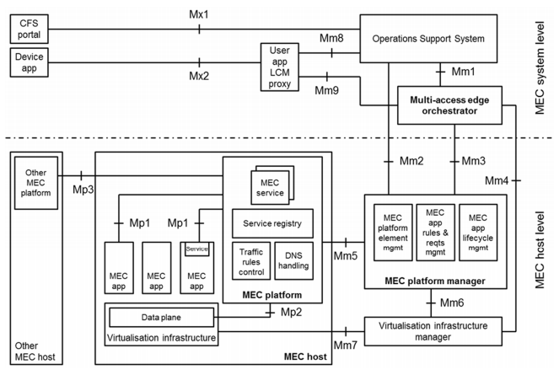
EdgeGallery Architecture Mapping with ETSI MEC (Management Part)
OSS
Application LCM
Application PkgM
Management
AppO
APM
Common Services
MEO
Platform Manager
Security Services
MM2
Configuration Mgmt
Fault Mgmt
Inventory
Logging
Infra Manager
Placement
Policy
DB etc.
Application LCM
Application PkgM
Application Lccn
MM4
MEPM
MEPM
MM5
Config Mgmt
Rules Mgmt
AppLCM Support
AppLCM
AppRules
Element management
Resource controller
APPLCM
Rules Mgmt
Element Mgmt
LCM Controller
K8s plugin
OS plugin
Future plugin
MM6
Virtualized Resource Mgmt
Resource Monitoring
Image Management
VIM
K8s/Future VIM

Slide 9
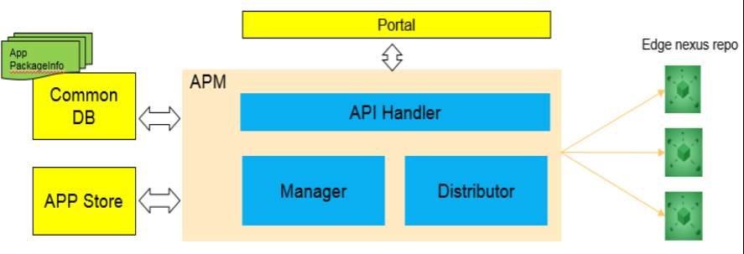

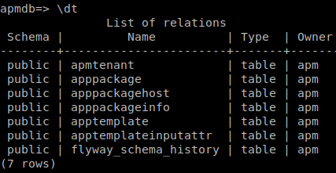
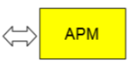
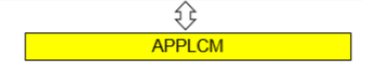
APM Details
Portal (mecm-fe)
Appstore/Developer
MM1
APM DB
(PG DB)
APM
API Handler
MECM
APM service
DB Service
Sync Service
Inventory
MM3
Package Synchronization
Get all available packages list from APP Store
Get package from AppStore
Package Validation (Security guidelines, Format)
Sync Docker Images from AppStore Harbor Repository to MECM Harbor Repository
Package Distribution to Desired Edge
Sync package (diff) from Edge (Autonomous Edges)
Developed in JAVA
Spring Boot Framework
Uses Docker Client
Note: There will be no image sync for VM based package

Slide 10
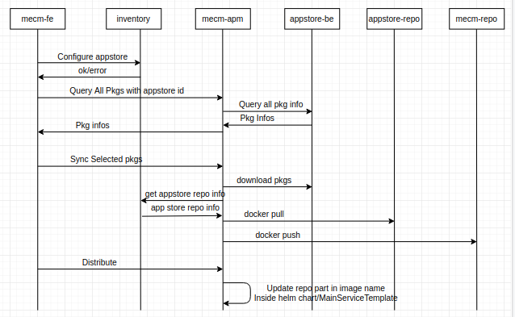
App Docker Image Sync Flow (From App Store Repo to MECM Repo)
Pre-Requisite
Get AppStore Info from Inventory
Package Synchronization
/mec/appstore/v1/apps
/mec/appstore/v1/apps/appId/packages
/apps/info/appstores/{appstore_ip}
(with AppID + PackageId)
/apps/sync
(with AppID + PackageId)
Package Distribution
/tenants/{tenant_id}/packages
(with AppID + PackageId)
&
(HOST_IP List)
Find MEPMs corresponding to host ips and onboard it to them

Slide 11
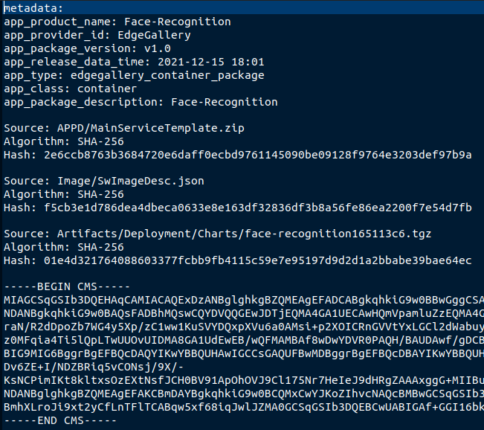
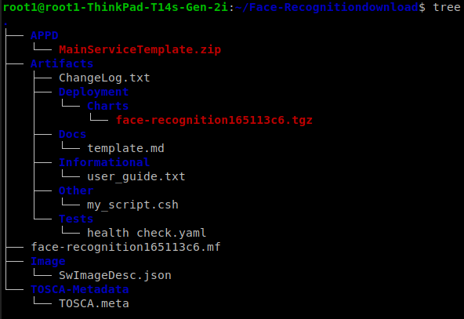

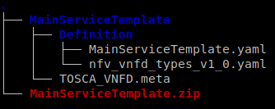
EdgeGallery Package
Manifest File: Metadata Information
Package (CSAR)
Image Folder:
Software Image Descriptor
Software Image (Optional)
[
{
"id": "9386590c-312f-4d95-a2a3-be924b8c8b6d",
"name": "face_recognition_app",
"version": "v1.4",
"checksum": "2",
"containerFormat": "bare",
"diskFormat": "raw",
"minDisk": 3,
"minRam": 6,
"architecture": "X86",
"size": 688390,
"swImage": "192.168.17.30/developer/face_recognition_app:v1.4",
"hw_scsi_model": "virtio-scsi",
"hw_disk_bus": "virtio",
"operatingSystem": "linux",
"supportedVirtualisationEnvironment": "linux"
},
{
"id": "4c155d49-8362-41c9-9b8f-c6f74cee6581",
"name": "postgres",
"version": "9.6.15",
"checksum": "2",
"containerFormat": "bare",
"diskFormat": "raw",
"minDisk": 3,
"minRam": 6,
"architecture": "X86",
"size": 688390,
"swImage": "192.168.17.30/developer/postgres:9.6.15",
"hw_scsi_model": "virtio-scsi",
"hw_disk_bus": "virtio",
"operatingSystem": "linux",
"supportedVirtualisationEnvironment": "linux"
}
]
Helm chart, used by k8s plugin to deploy on ks8 cluster using helm client

Slide 12
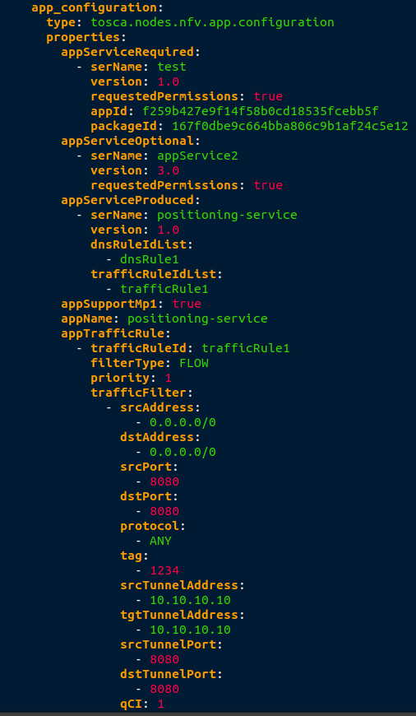
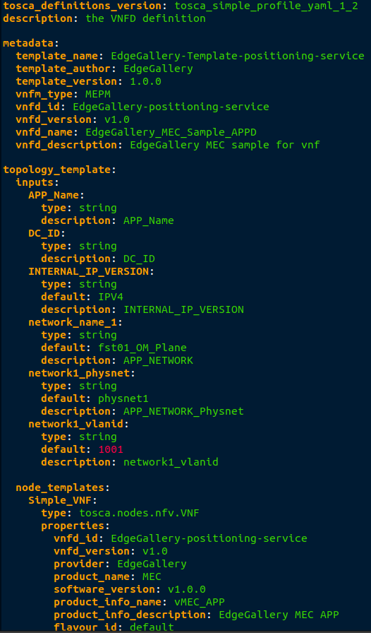
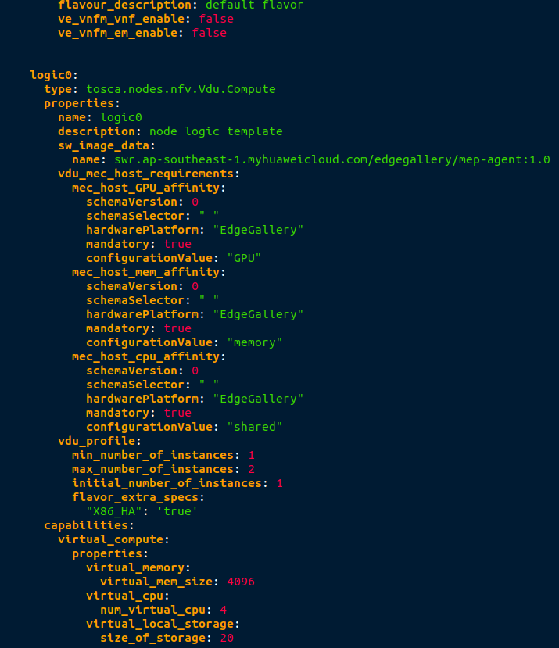
EdgeGallery Package: MainServiceTemplate (TOSCA)

Slide 13
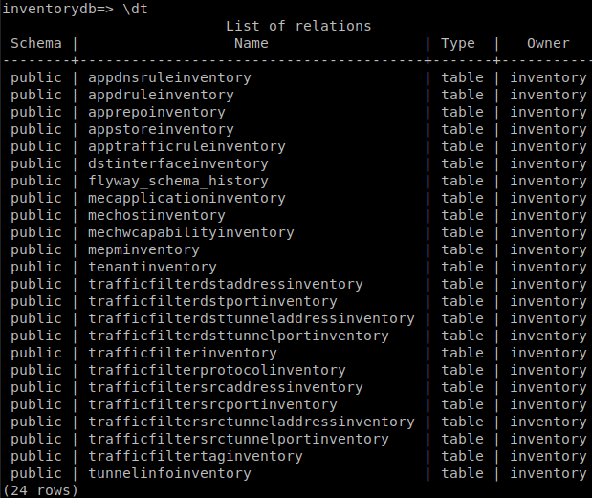


Inventory Details
Portal (mecm-fe)
No Standard
Inventory
Common
DB
Inventory DB (PG DB)
No Standard
Inventory Service: Store to Inventory DB
Inventory of: ESR Info (Host, MEPM, Repositories, AppStore etc.), Tenant, AppInstance, AppD (Traffic/DNS Rule) etc.
Config Service: Infrastructure configuration in MECM, currently only to upload k8s config file to MEPM.
Sync inventory (diff) from Edge (Autonomous Edges)
Developed in JAVA
Spring Boot Framework
Uses PG DB
Note: Relationship among all tables needs improvement.

Slide 14
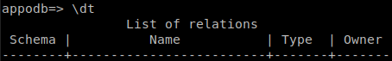
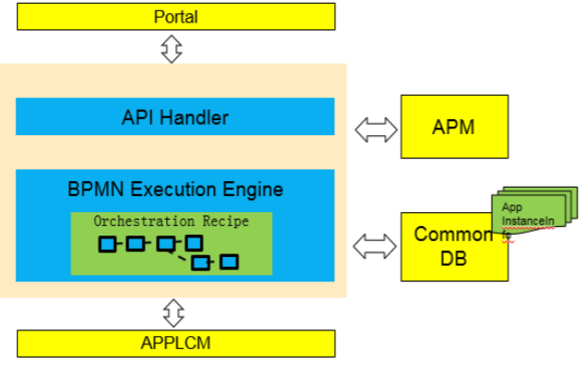
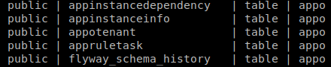
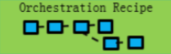
APPO Architecture
Portal (mecm-fe)
MM1
API Handler
Inventory
BPMN Execution Engine
APPO DB
(PG DB)
MM3
AppLCM/ AppRuleMgr/ ResourceController
Application orchestrator
Create & Instantiate operation on APP Instance
AppD rule configurations
Developed in JAVA
Spring Boot Framework
BPMN based workflow definition & execution using Camunda

Slide 15
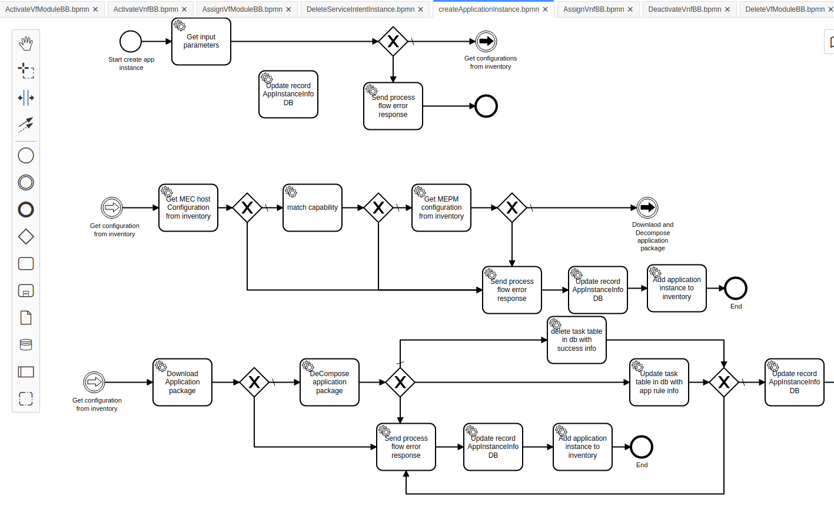
APPO Architecture Workflow..

Slide 16


APPLCM with Plugins Architecture
Portal (Appo/mepm-fe)
MM3
APPLCM
LCM Controller
MM5
lcmcontrollerDB (PG DB)
MEP
Plugin adapter
DB adapter
GRPC
K8s plugin
OS plugin
Future plugin
Helm Client
python-openstackclient
MM6
VM
Considering the footprint on edge, MEPM module are built using GOlang and uses GRPC to communicate with other MEPM modules.
Plug n Play of Infrastructure VIM
Re-used opensource VIM clients
Specific of VIM is only there with plugins

Slide 17
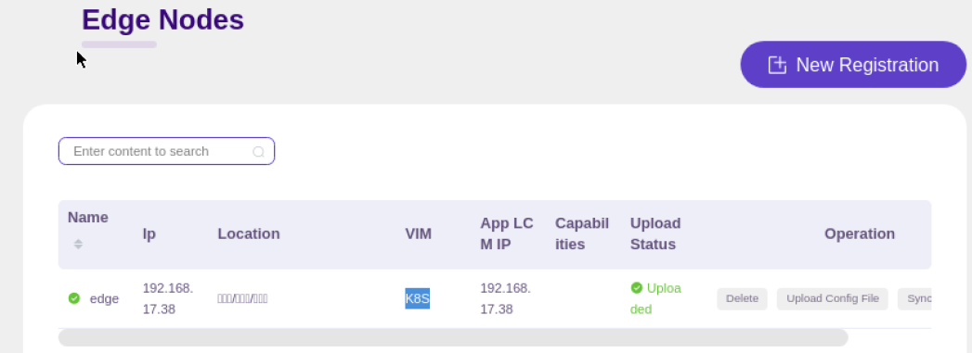
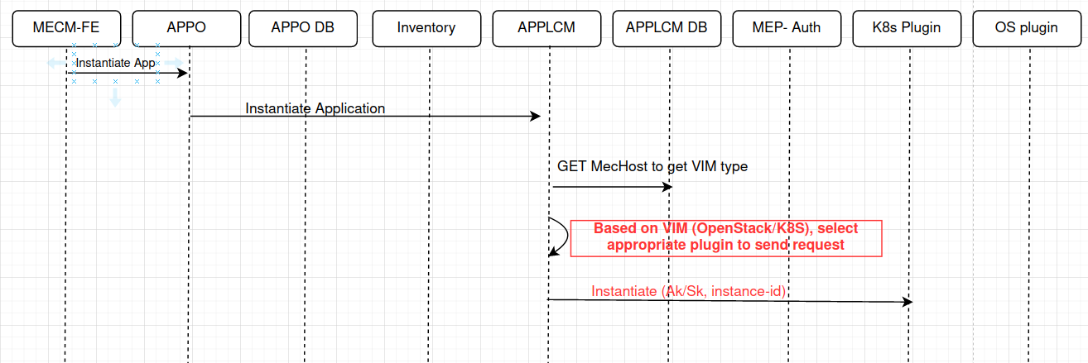
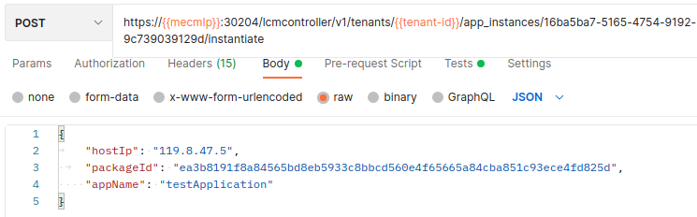
APPLCM: Plugin Selection Logic
Step 1: During Edge Registration, specify VIM type, this information will also be added to APPLCM
Step 3: APPLCM finds plugin based on Host IP from registered information
Step 2: While Instantiation, APPO sends MEC Host IP (Edge IP) to APPLCM

Slide 18
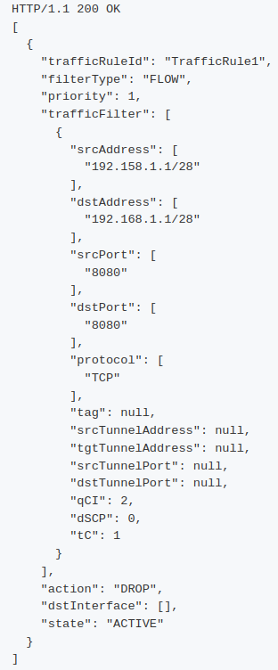
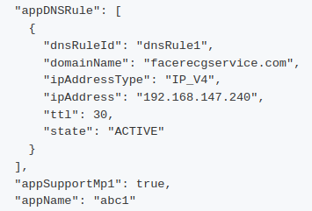
AppRuleMgr Architecture
MEO/mepm-fe
MM2(via MEO) or MM3
App Rule Manager
AppRuleMgr DB(PG DB)
MM5
MEP
GOLANG & GRPC
Separate Microservice

Slide 19
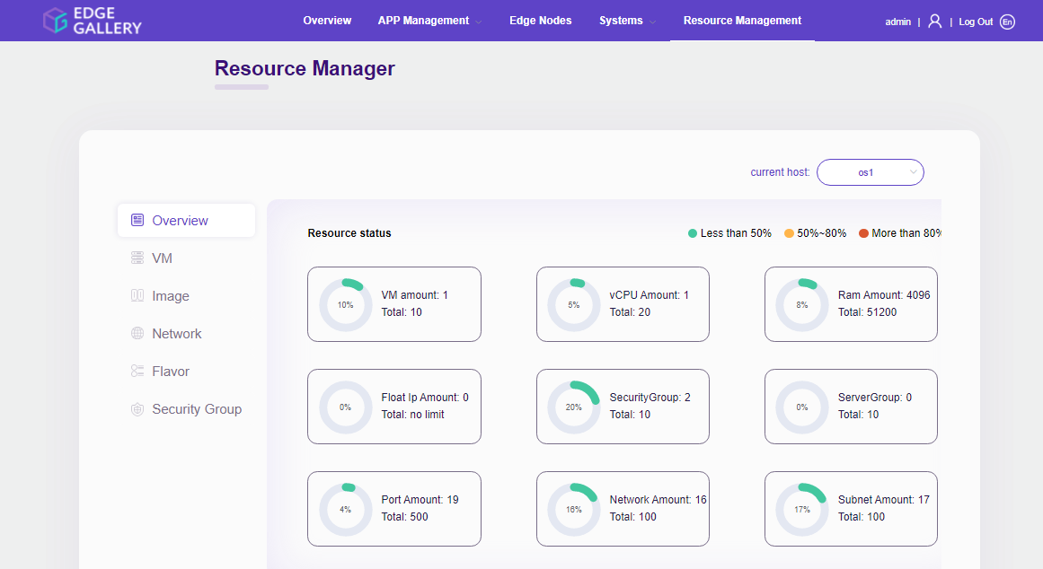
Resource Controller
Portal (mecm-fe)
MEO
MEPM
Added Resource Controller module on edge side, that provide CRUD apis for network, images, security group, SecurityGroup rule, flavor and vm.
GOLANG & GRPC
Resource Controller
Res Controller
lcmcontrollerDB(PG DB)
Plugin adapter
DB adapter
GRPC
OS plugin
python-openstackclient
MM4

Slide 20
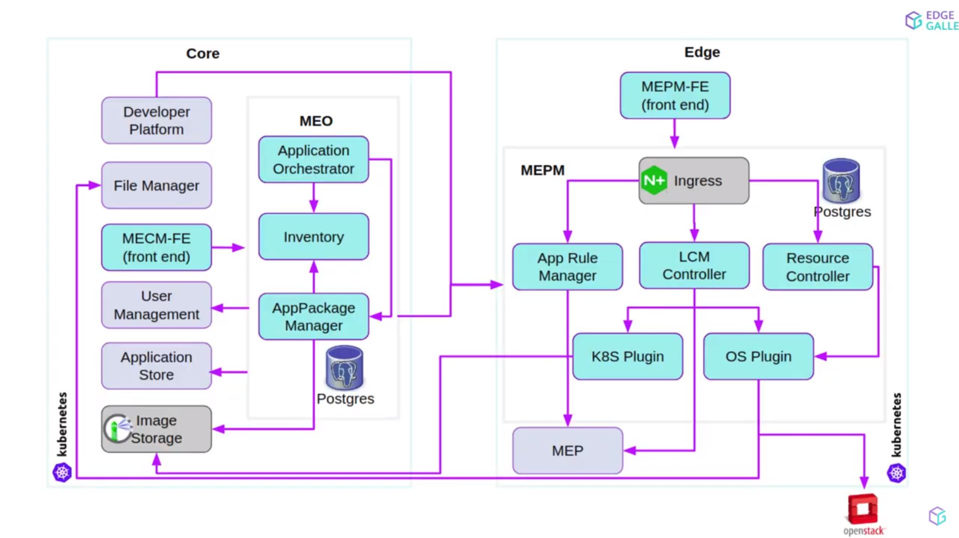
MECM Deployment Overview

Slide 21
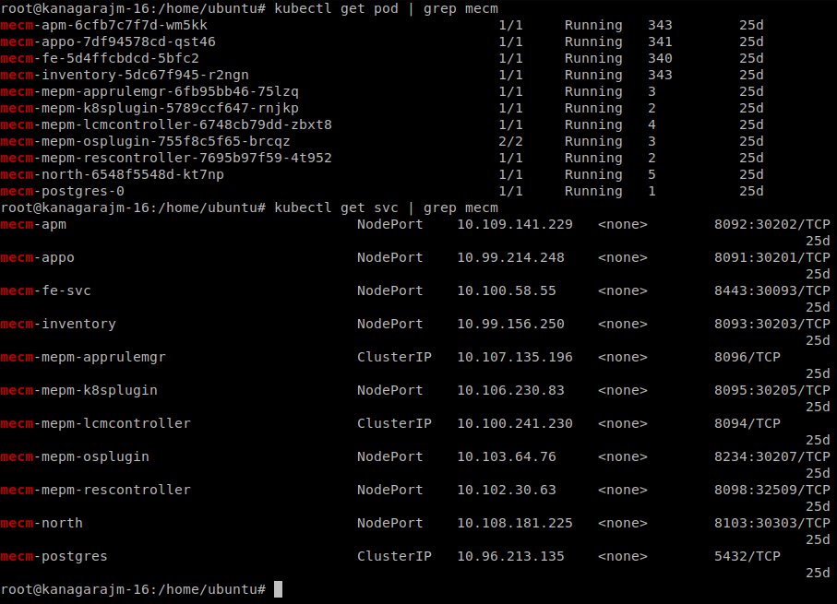
MECM Deployment Overview cont..

Slide 22
Important Models

Slide 23
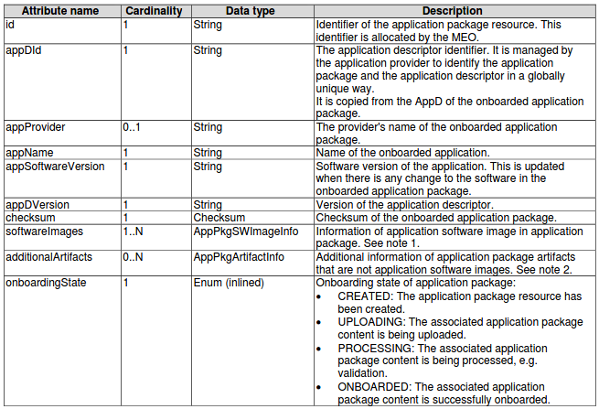
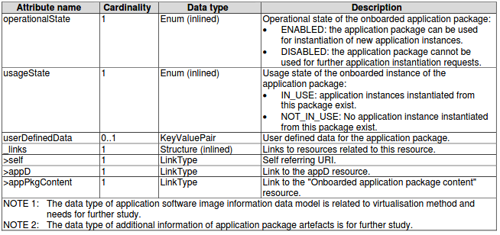
EdgeGallery Application package management information model Alignment with ETSI MEC
AppPkgInfo: The data type AppPkgInfo represents the parameters for an
application package resource
EdgeGallery Existing App package info
Attribute Name | Description
id | Unique id
app_pkg_id | Application package id
app_pkg_name | Application pkg name
app_pkg_version | Application pkg version
app_pkg_path | Application package path
app_provider | Application provider
app_pkg_desc | Application pkg descriptor
app_pkg_affinity | Application pkg affinity
app_icon_url | Application icon url
app_id | Application id

Slide 24
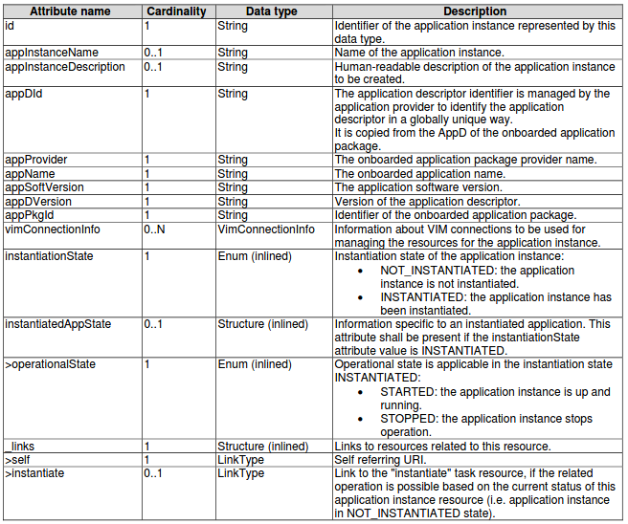
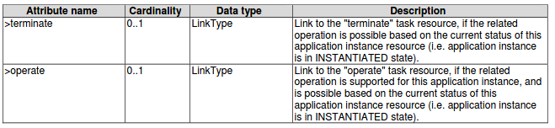
EdgeGallery Application lifecycle management information model Alignment with ETSI MEC
AppInstanceInfo: The data type of AppInstanceInfo represents
the parameters of instantiated application instance resources.
EdgeGallery Existing App Instance info
Attribute Name | Description
app_instance_id | Application inst id
app_package_id | Application pkg id
app_id | Application id
tenant | Tenant id
app_name | Application name
app_descriptor | Application descriptor
mec_host | MEC host
applcm_host | Applcm host
operational_status | Operational status
operation_info | Operations info

Slide 25
APPD Model - TODO

Slide 26
Flows

Slide 27
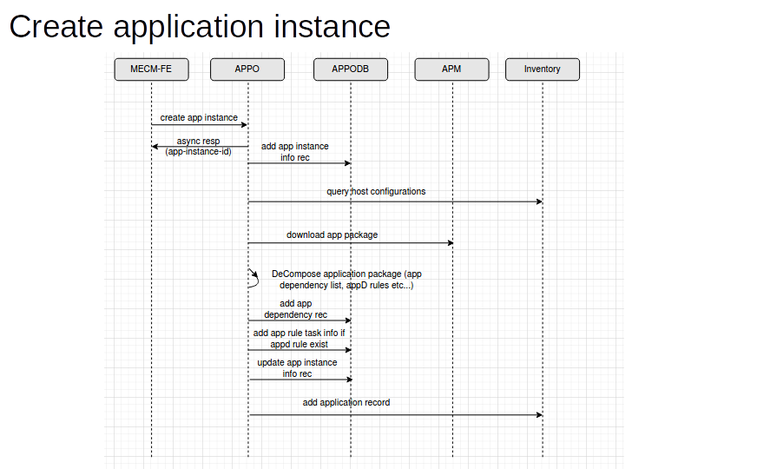
Application Deployment: Create
/tenants/{tenant_id}/app_instances
/inventory/v1/tenants/{tenant_id}/mechosts/{mec_hos`t}
/apm/v1/tenants/{tenant_id}/packages/{app_package_id}/download
/inventory/v1/tenants/{tenant_id}/mechosts/{mec_host}/apps

Slide 28
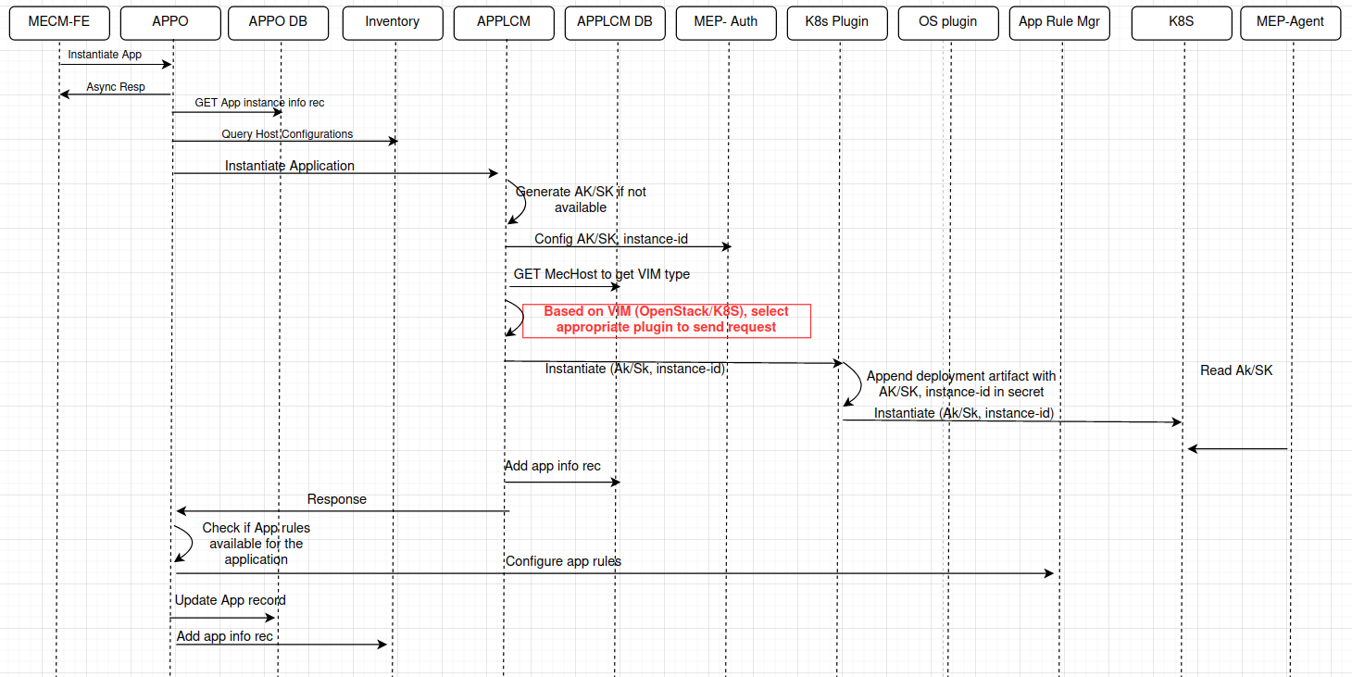
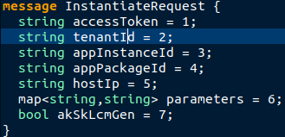
Application Deployment: Instantiate
/tenants/{tenant_id}/app_instances/{app_instance_id}
/inventory/v1/tenants/{tenant_id}/mechosts/{mec_hos`t}
/lcmcontroller/v2/tenants/{tenant_id}/app_instances/{app_instance_id}/instantiate
/kongIP:Port/mep/appMng/v1/applications/AppInsId/confs
Helm client

Slide 29
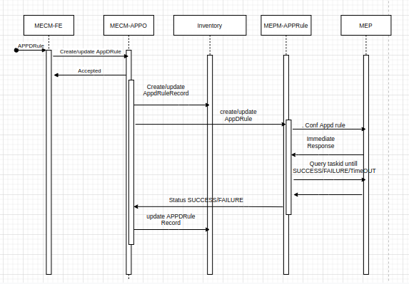
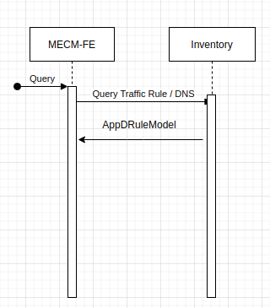
Appd Rule Configuration (MM2)

Slide 30
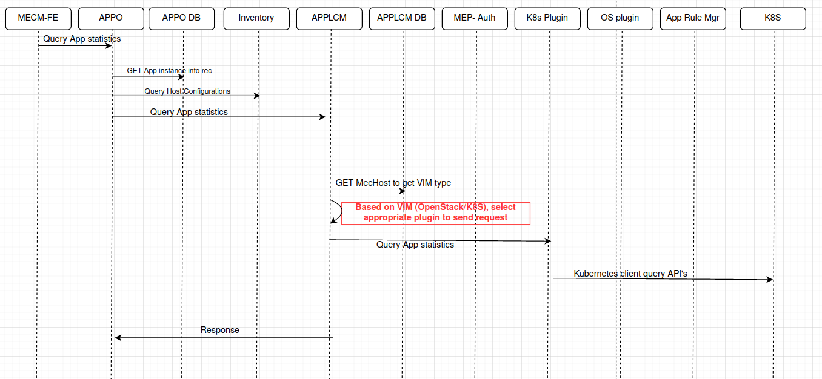
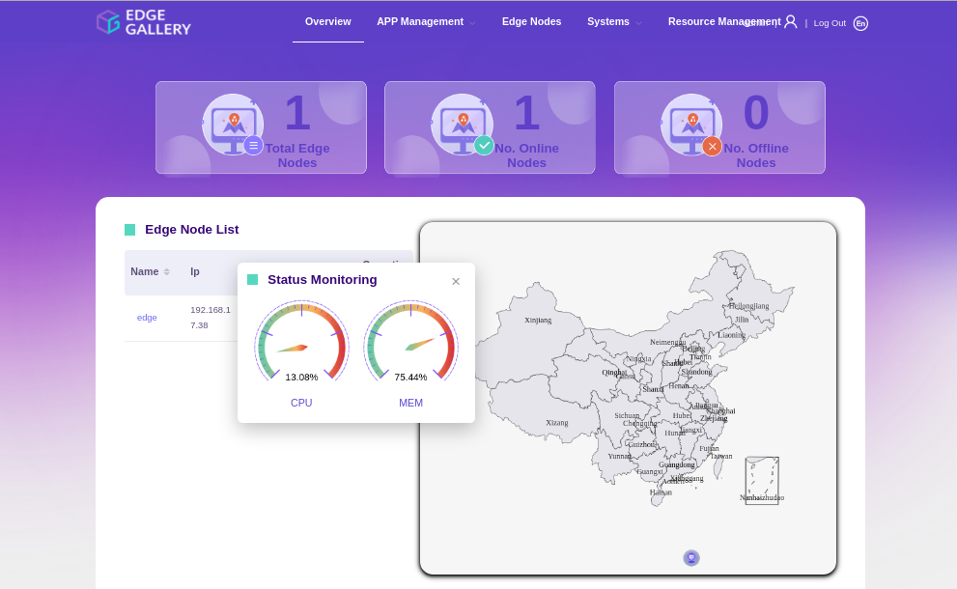
Monitoring/Statistics:

Slide 31
Autonomous Edge

Slide 32

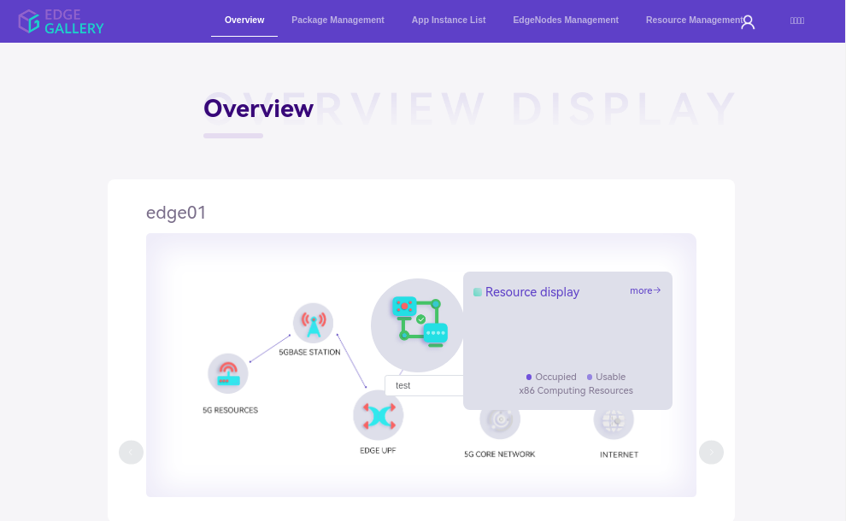
MEPM FE

Slide 33
VM Based Application

Slide 34
Service Comb

Slide 35
References: TODO
https://www.bilibili.com/video/BV1Bh411q7kx/
https://www.bilibili.com/video/BV1V3411r7qb/
https://www.youtube.com/watch?v=Ka6Es9A5v_4

Slide 36
Thanks

Slide 37
EdgeGallery Flow Alignment with ETSI MEC
EdgeGallery Existing Flow
Application package management
Application package management
OSS
MEO
MEPM
INFRA
OSS
APM
INFRA
OnBoard app Pkg
OnBoard app Pkg
appPkgId, appDId
validate
App pkg id
App pkg Onboard Notification
Create AppPackage info
Fetch app pkg
Upload application image to edge
Upload application image to edge
Query app pkg info
Query app pkg info
Query app pkg info
app pkg info
This flow can be used by the MEPM to obtain the application requirements, traffic redirection rules and DNS rules that it needs to configure the MEC platform to run the application.
app pkg info
Disable/Enable app package
AppPackageState
ChangeNotification
Delete app package
Delete application image from edge
Delete appPkg
Delete AppPackage info
AppPackageState
ChangeNotification
Not Implemented

Slide 38
EdgeGallery LCM Flow Alignment with ETSI MEC
EdgeGallery Existing LCM Flow
OSS
MEO
MEPM
INFRA
OSS
MEO
MEPM
APM
INFRA
Create identifier
Create identifier
Create identifier
Create AppInstance
info
Create AppInstance info
App instance id
AppInstanceIdentifierCreationNotification
Download application package
App instance id
App instance id
Instantiate app
Instantiate app
lifecycleOperationOccurrenceId
Instantiate app
lifecycleOperationOccurrenceId
Instantiate app
Start,Lifecycle
ChangeNotification
Deploy and start application
Start,Lifecycle
ChangeNotification
Grant request
Query App pkg info
Deploy
result,Lifecycle
ChangeNotification
result,Lifecycle
ChangeNotification
Query app instance
Change app instance operation state
Change app instance operation state
Query app instance
lifecycleOperationOccurrenceId
Get application status
lifecycleOperationOccurrenceId
Start,Lifecycle
ChangeNotification
Start,Lifecycle
ChangeNotification
start/stop app instance
result,Lifecycle
ChangeNotification
result,Lifecycle
ChangeNotification
Terminate app Instance
Query app instance info
Terminate app Instance
Query app instance info
unDeploy application instance
appInstanceInfo
appInstanceInfo
Delete AppInstance info

Slide 39
EdgeGallery LCM Flow Alignment with ETSI MEC cont..
OSS
MEO
MEPM
INFRA
Query LCM oper status
lifecycleOperationOccurrenceId
Query LCM oper status
PROCESSING,
SUCCESSFULL_DONE, FAILED
operationStatus
operationStatus
Terminate app inst
Terminate app inst
lifecycleOperationOccurrenceId
lifecycleOperationOccurrenceId
Terminate and release resource
Delete identifier
Delete identifier
Delete AppInstance
info
AppInstanceIdentifier
Deletion Notification
AppInstanceIdentifier
Deletion Notification
Not Implemented

Slide 40
MECM Flows

Slide 41
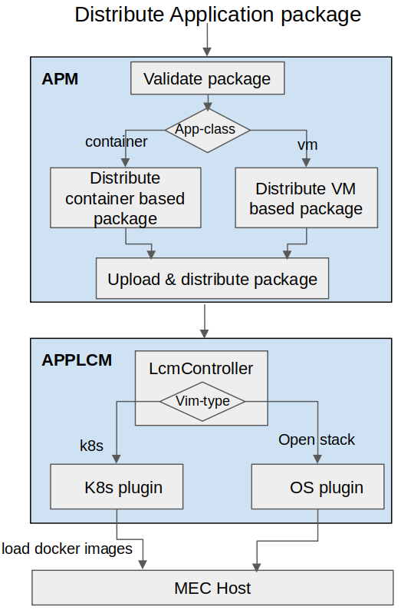
Application Package Distribute Flow
1.App-class attribute from manifest file can be “container” or “vm”.
2.When app-class attribute is “container”, read swImageDescr
i.App package may include docker image or image url.
ii.When docker image is available in package, save &
load docker images to mecm-repo if image does not
exist in repo.
iii.When docker image url is available, download
docker images from source repo using source repo
config from inventory and upload to mecm-repo if
image does not exist in repo.
iv.Upload app package to applcm.
V.Distribute application package to applcm’s(k8s-plugin)
for the selected edge hosts.
Vi.k8s plugin load docker images to MEC host.
3.When app-class attribute is “vm”, read swImageDescr
i.App package includes vm image url, points to image management.
ii.Upload app package to applcm.
iii.Distribute application package to applcm’s(os-plugin)
for the selected edge hosts.

Slide 42
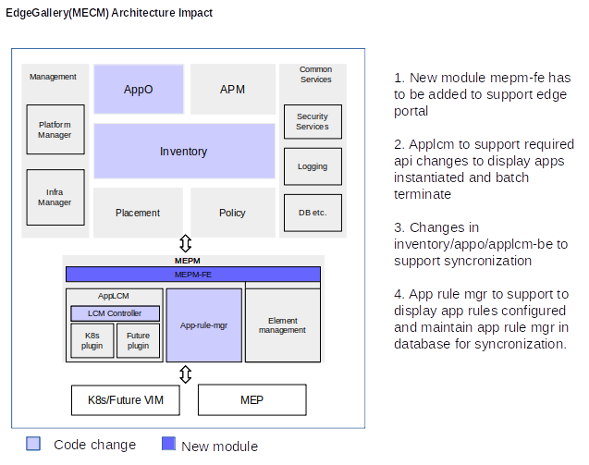
Autonomous Edges

Slide 43
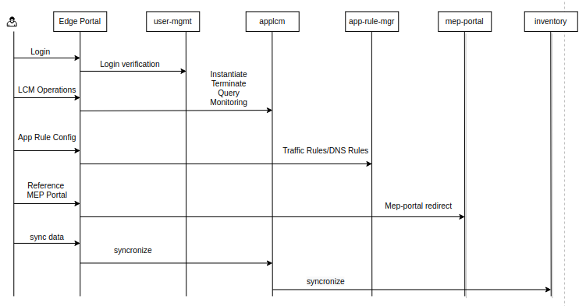
Autonomous Edges

Slide 44
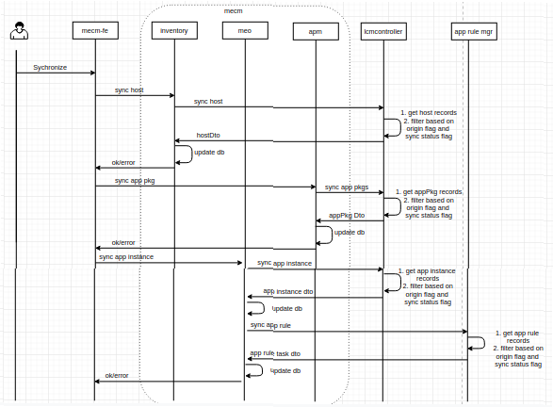
Autonomous Edges

Slide 45
Service center

Slide 46
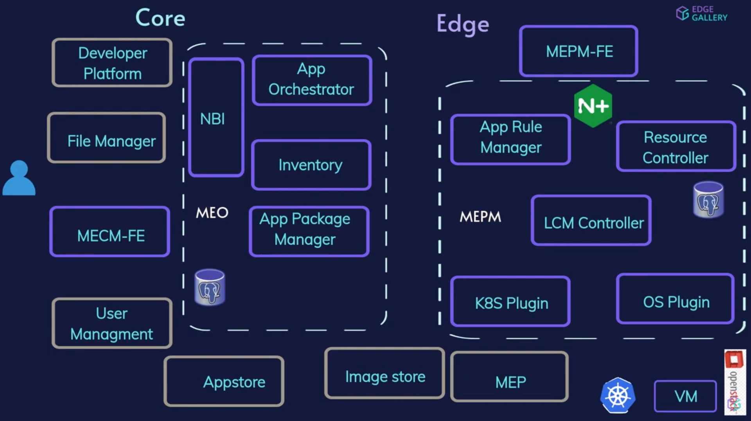

Slide 47
VM based application support
Edge Autonomous
Service Comb

Slide 48
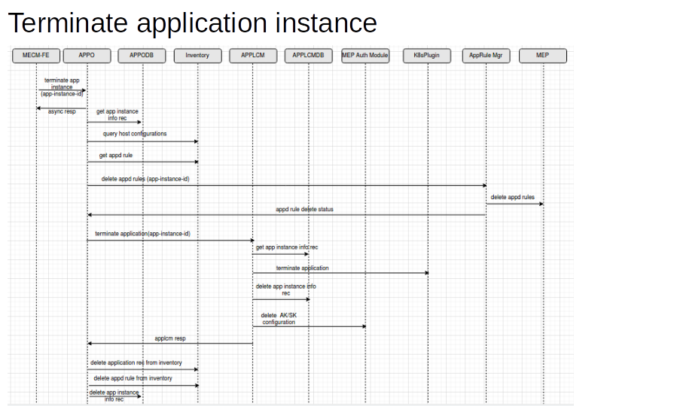
Application Instance Terminate Flow: TODO

